Slide 1

The Uplink Visible Light Communication Beacon System for Universal Traffic Management
Presented By :
Rajasekhar PS
1DT17EC410
Guided By :
Dr.Siddalingappagouda Biradar
Associate Professor, DSATM

Slide 2

Introduction
Literature Survey
Problem Statement
Objectives
Methodology
Preliminary experiments
Throughput measurement for driving conditions
Conclusion
References
2

Slide 3

Fifth-generation (5G) wireless systems are expected to provide higher capacity than current 4G systems.
Three merging technologies primarily support 5G: ultra densification, millimetre wave, and massive multiple-input multiple-output (MIMO).
In addition, the concept of network slicing is expected to improve the operation of communication networks. Demand for 5G comes from big vertical industry sectors, such as automotive, factory, health, energy, and media & entertainment.
For automotive and smart mobility use, 5G reduces fatal accidents and lessens traffic congestion when used in the cooperative automatic driving.
3

Slide 4
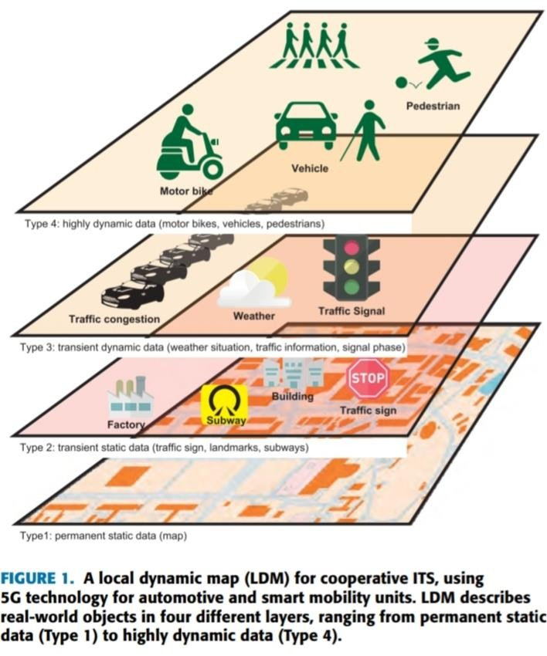
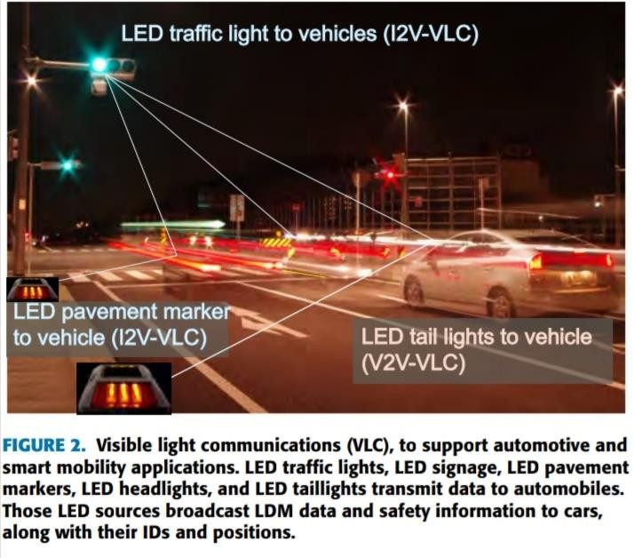
For automotive and smart mobility use, 5G reduces fatal accidents and lessens traffic congestion when used in the cooperative automatic driving.
Mobile edge computing (MEC) and local dynamic maps (LDMs) are key technologies for advanced driver assistance systems and complete autonomous cars.
4

Slide 5

Smart home multi-device bidirectional visible light communication.
Optical bidirectional beacon based visible light communication.
A high speed bidirectional visible light communication system based on RGB-LED.
Image sensor based visible light communication for automotive application.
5

Slide 6

Special section on optical wireless technologies for 5G communications and beyond.
The uplink visible light communication beacon system for the universal traffic management system (UTMS).
6

Slide 7

This paper presents a feasibility study of the uplink visible light communication (VLC) beacon system for the universal traffic management
system (UTMS).
Evaluate the performance of the VLC beacon
We follow the system configuration of the current
system.
infrared beacon system to reduce the replacement cost.
The system is designed to match the current beacon system as closely as possible, so that the system can easily be replaced and still provide sufficient bandwidth for future automotive and smart mobility devices.
7

Slide 8

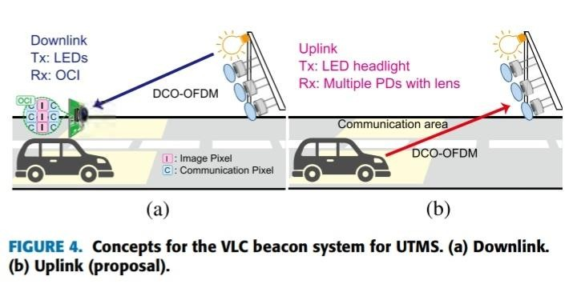
1. VLC beacon system for UTMS. a)up-link
b)down-link
8

Slide 9

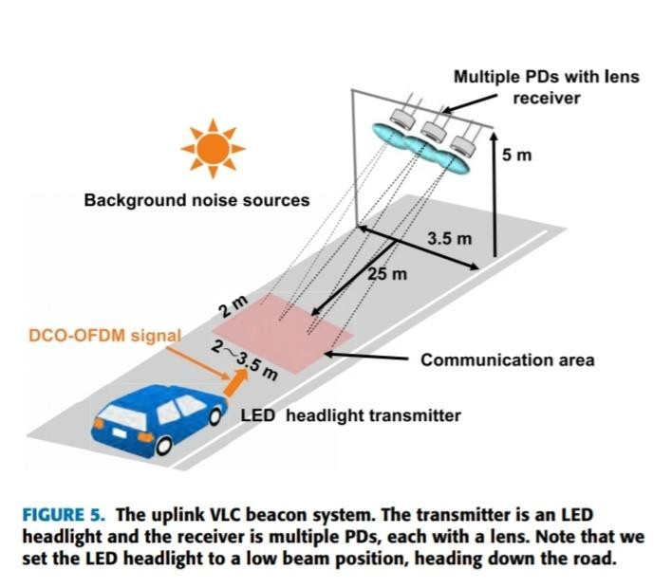
Figure 5 illustrates the proposed uplink VLC beacon system.
For the downlink, we select an LED as a transmitter and an OCI for the onboard reception device. Again, we adopt a DCO-OFDM as the modulation scheme
9

Slide 10
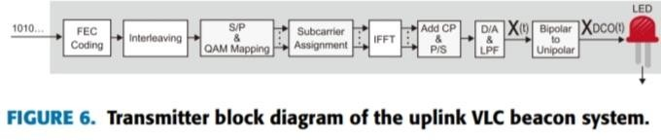
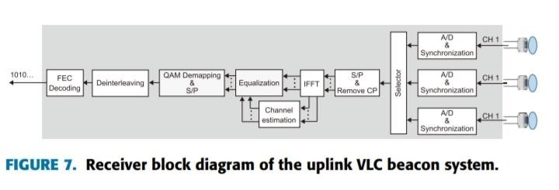
2. System model of the up-link VLC beacon system. a)Transmitter
b)Receiver

Slide 11
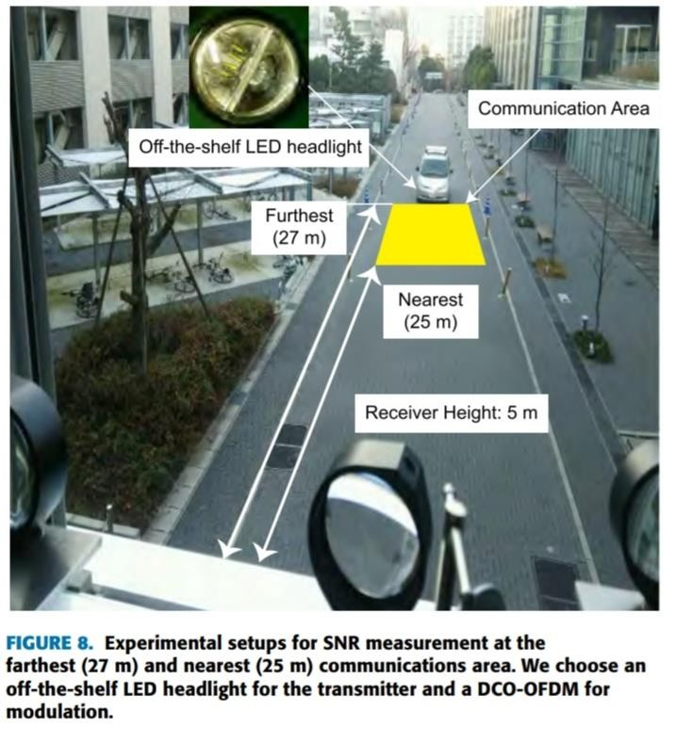
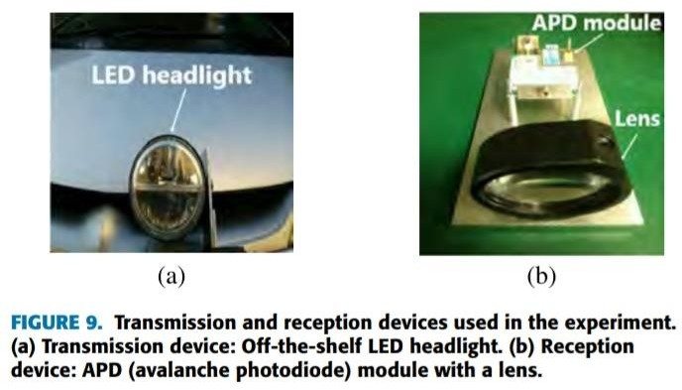
The purpose of the preliminary experiments is to confirm the feasibility of a VLC beacon system using an off-the-shelf LED headlight as shown in the figure 8.
Illuminating the LED headlight at five meters above the ground in low beam position and it is shown in the figure 9.

Slide 12
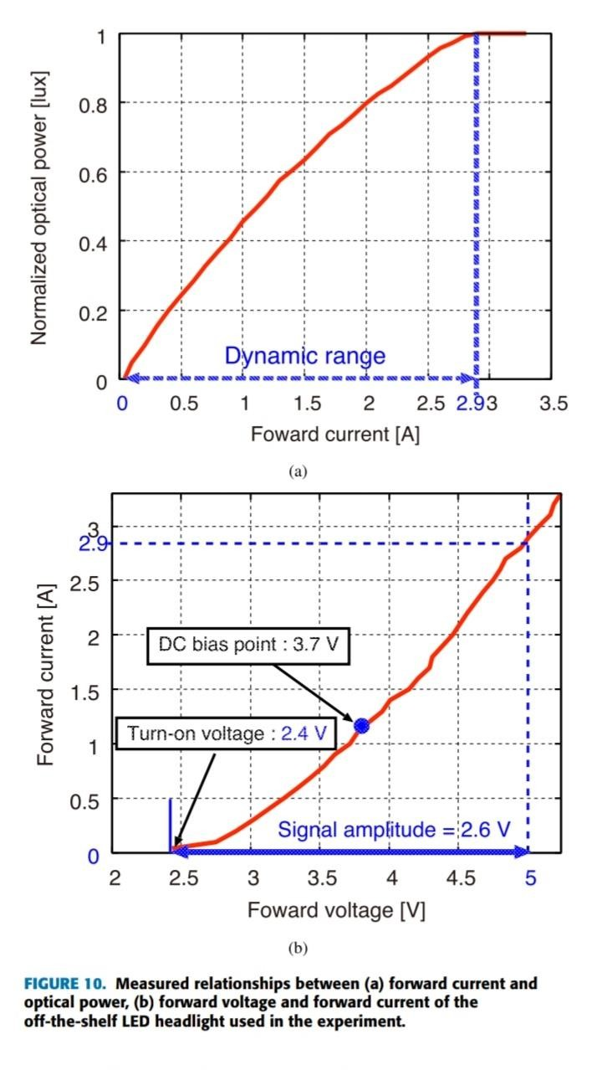
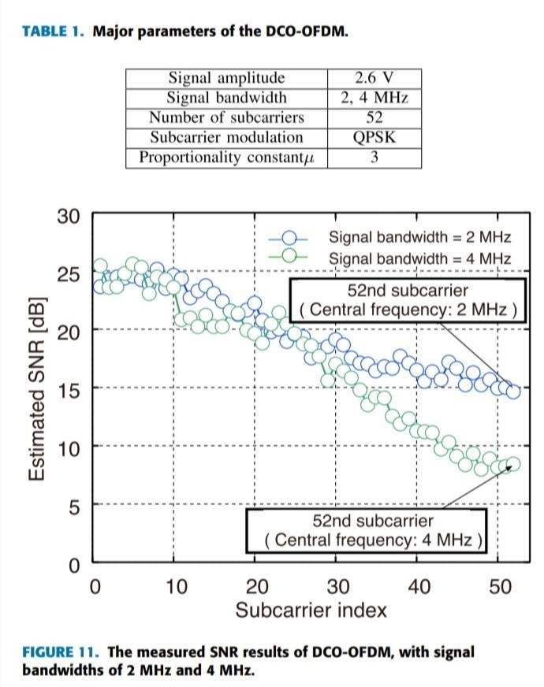
Linearity of the LED headlight.
LED headlight bandwidth measurement.

Slide 13
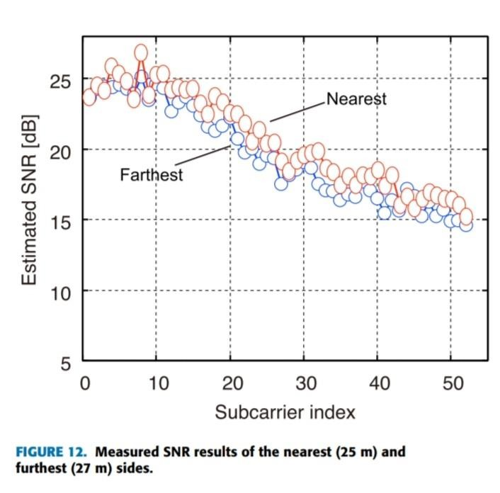
SNR at the farthest and nearest communications area.

Slide 14
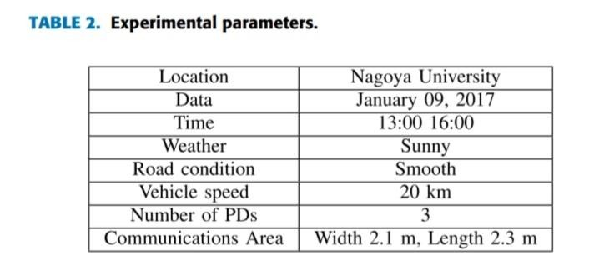
a)Experimental setup:
To evaluate the of the VLC beacon system we conducted data transmission experiments as shown in the figure 13.
We used a digital oscilloscope to capture the received signal and performed the demodulation offline using Mat lab/Simulink software.
Experimental parameters are summarized in the table 2.

Slide 15
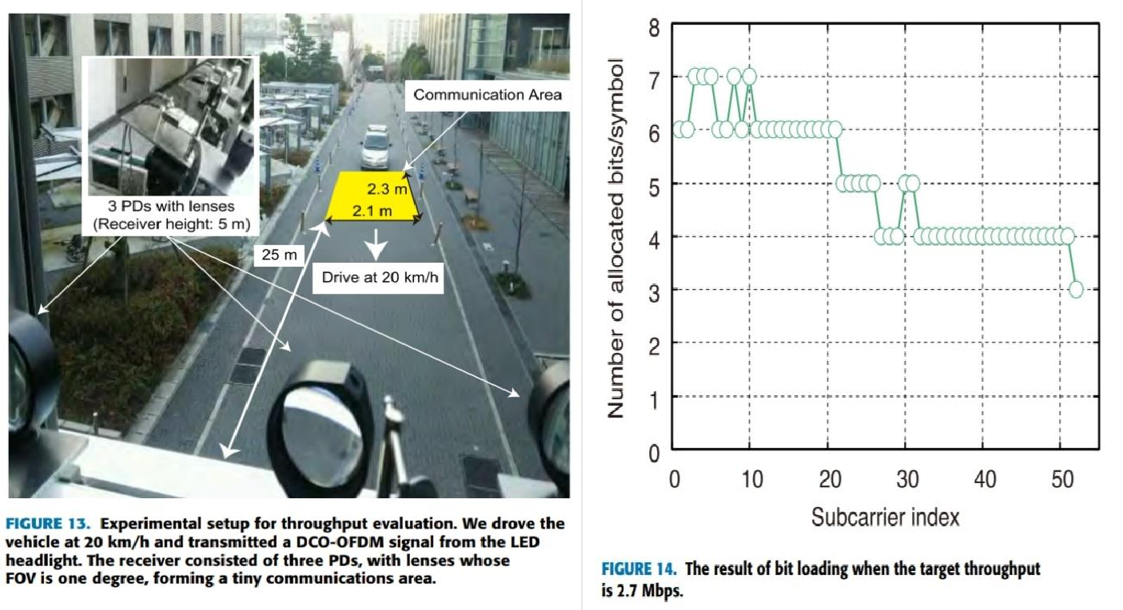

Slide 16
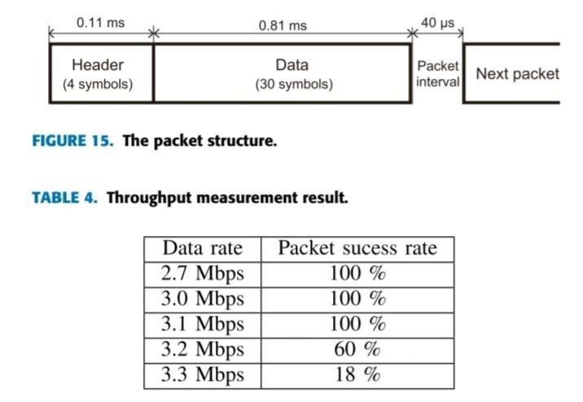
b) Throughput measurement:
To evaluate the performance of the VLC beacon system, data transmission experiments are conducted.
We measure the packet success rate for a given data rate.
The packet success rate is calculated as the number of successfully received packets over the number of packets sent to the vehicle in the communication area.

Slide 17

In this paper, we presented a feasibility study of the uplink VLC beacon system for UTMS.
We designed the system to meet the current beacon system as closely as possible and still provide demand for future automotive and smart mobility devices.
Our results achieved 3.1 Mbps throughput.

Slide 18

A. Osseiran et al., ‘‘Scenarios for 5G mobile and wireless communications: The vision of the METIS project,’’ IEEE Commun. Mag., vol. 52, no. 5, pp. 26–35, May 2014.
J. G. Andrews et al., ‘‘What will 5G be?’’ IEEE J. Sel. Areas Commun., vol. 32, no. 6, pp. 1065–1082, Jun. 2014.
Euro 5G project and 5G Infrastructure Association. (Feb. 2016). 5G Empowering
Vertical Industries, Vision Paper. [Online]. Available: https://5g-ppp.eu/roadmaps/
5G PPP. (Oct. 2015). 5G Automotive Vision, White Paper. [Online]. Available: https://5g-ppp.eu/wp-content/uploads/2014/02/5G-PPP-WhitePaper-on-
Automotive-Vertical-Sectors.pdf
M. Patel, B. Naughton, C. Chan, N. Sprecher, S. Abeta, and A. Neal. (Sep. 2014). Mobile-Edge Computing—Introductory Technical White Paper. [Online]. Available: https://portal.etsi.org/portals/0/tbpages/ mec/docs/mobile-edge_computing_-
_introductory_technical_white_ paper_v1%2018-09-14.pdf

Slide 19
Intelligent Transport Systems (ITS); Vehicular Communications; Basic Set of Applications; Local Dynamic Map (LDM); Rationale for and Guidance on Standardization, document ETSI TR 102 863 V1.1.1 (2011-06), Jun. 2011. [Online]. Available: http://www.etsi.org/deliver/ etsi_tr/102800_102899/102863/01.01.01_60/tr_102863v010101p.pdf
Intelligent Transport Systems—Extension of Map Database Specifications for Applications of Cooperative ITS, document ISO 14296:2016, Feb. 2016. [Online]. Available: https://www.iso.org/standard/54587.html
H. Shimada, A. Yamaguchi, H. Takada, and K. Sato, ‘‘Implementation and evaluation of local dynamic map in safety driving systems,’’ J. Transp. Technol., vol. 5, no. 2, pp. 102–112, Apr. 2015.
G. K. H. Pang and H. H. S. Liu, ‘‘LED location beacon system based on processing of digital images,’’ IEEE Trans. Intell. Transp. Syst., vol. 2, no. 3, pp. 135–150, Sep. 2001.
T. Nguyen, A. Islam, T. Hossan, and Y. M. Jang, ‘‘Current status and performance analysis of optical camera communication technologies for 5G networks,’’ IEEE Access, vol. 5, pp. 4574–4594, 2017.

Slide 20



